Slide 1
CSAT analytics
Call Center Performance Insights
US Call Center Dataset • 32,941 Records • 2020
32,941
2.07 / 10
25.02 min
Total Calls
Avg CSAT Score
Avg Call Duration
Notes:
Introduce the CSAT analytics project. Dataset covers 32,941 call center records across 4 US centers. Average CSAT of 2.07/10 is the headline problem.

Slide 2
About Dataset:
The goal of this project is to identify patterns, trends, and insights that can be used to optimize customer service processes, improve customer satisfaction, and enhance the overall customer experience.
This particular dataset holds 12 columns and 32,942 records. The 12 columns have information like their customer's name, sentiment, CSAT score, call timestamp, reason for the call, city, state, channel used, response time, and call duration in minutes which is used to analyze customer satisfaction and to identify common issues or concerns, and optimize customer service processes

Slide 3
Task:
Create line Chart for the call trends.
Create a doughnut chart for the Call channel.
Create a map for the states.
Create a column chart for the reason of calling.
Create a bar chart for the response time.

Slide 4
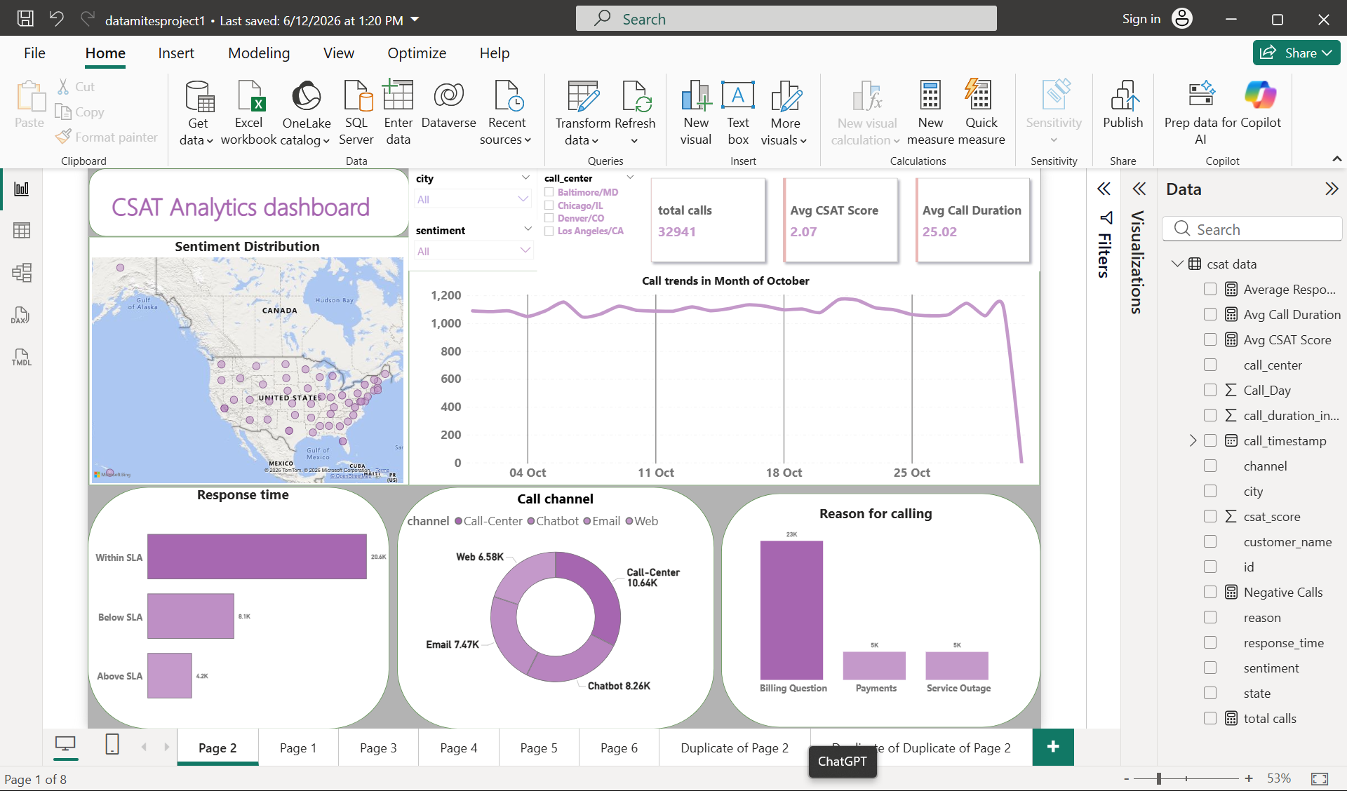

Slide 5
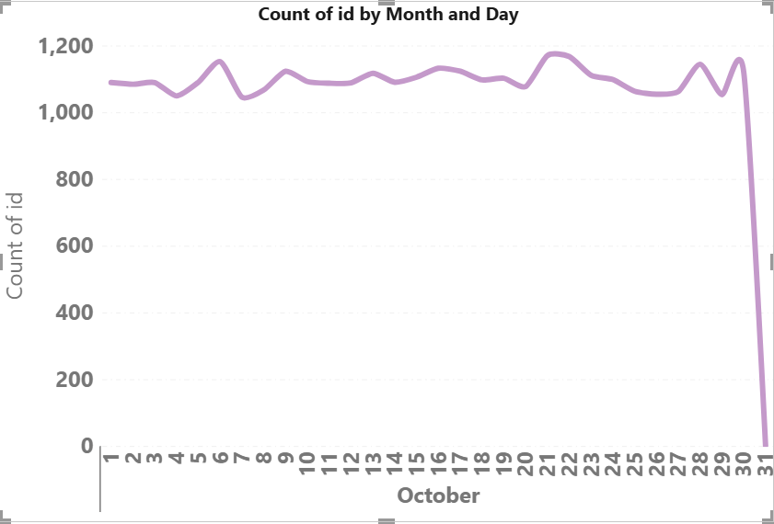
Create line Chart for the call trends.
Daily Volume Trend (October)
Consistent 1,050– 1,175 contacts/day throughout October

Slide 6
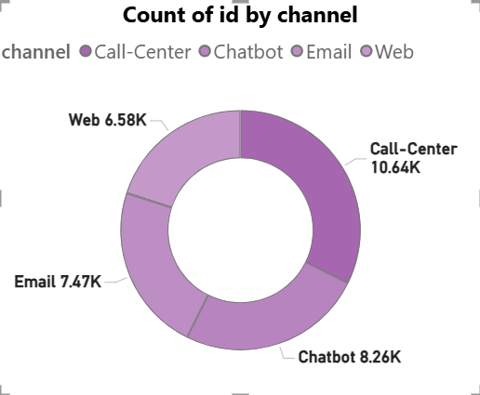
2. Create a doughnut chart for the Call channel.
Channel Distribution
Call-Centre dominates at 10.64K (32%), followed by Chatbot 8.26K (25%), Email 7.47K (23%), Web 6.58K (20%)
Volume is relatively balanced across channels, but call-centre dependency is highest — a cost concern

Slide 7
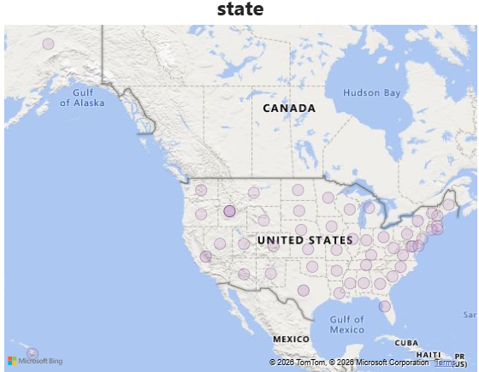
3. Create a map for the states.
Geographic Distribution
Bubble map shows spread across most US states
Higher density visible in the Northeast, Southeast, and parts of the South/Midwest — aligns with population centres

Slide 8
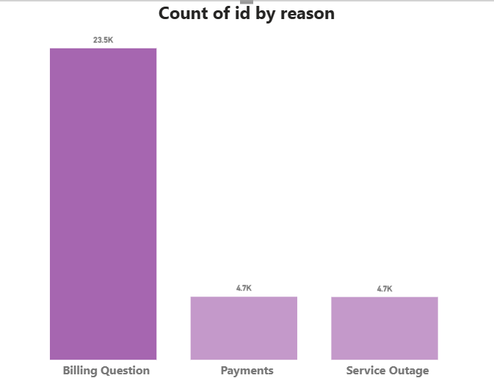
4. Create a column chart for the reason of calling.
Contact Reasons
Billing Question is overwhelmingly dominant at 23.5K vs Payments and Service Outage at 4.7K each
71% of all contacts are billing-related — points to a self-service or billing clarity gap

Slide 9
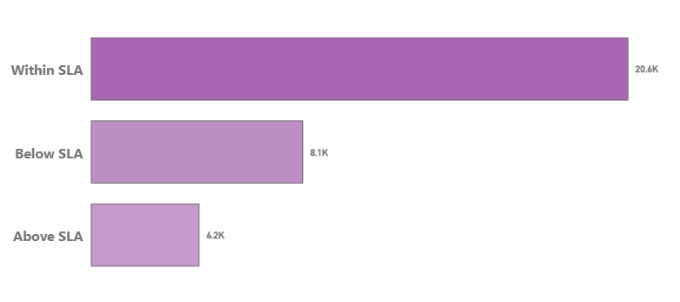
5. Create a bar chart for the response time.
Response Time
20.6K Within SLA, but 8.1K Below SLA + 4.2K Above SLA = 12.3K (37%) outside SLA
That's a significant compliance gap likely dragging CSAT down

Slide 10
Thank you

